Slide 1
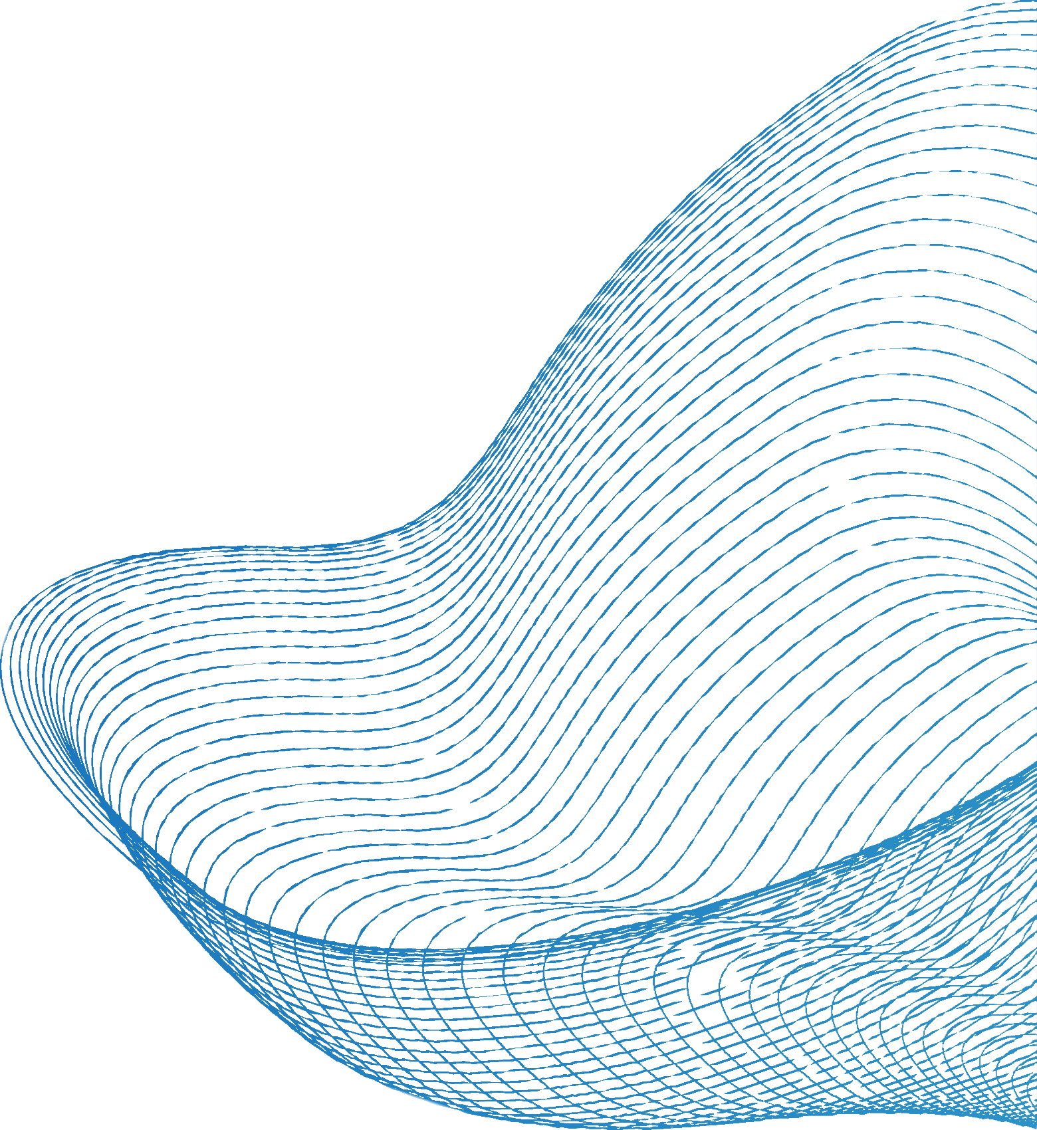


WEB DEVELOPMENT
BY- MITALI TRIVEDI

Slide 2
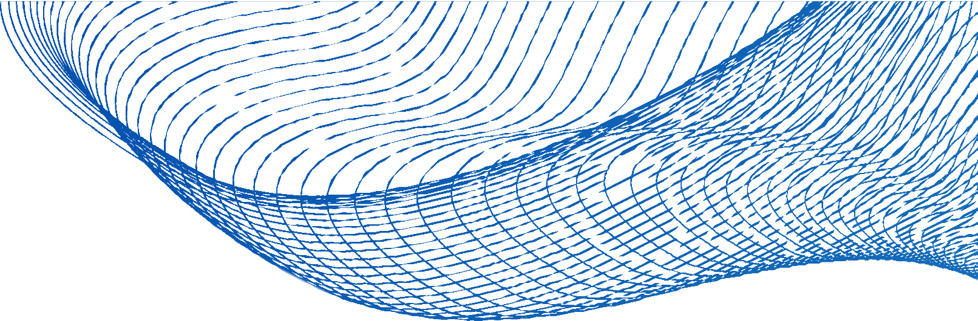
TABLE OF CONTENT
INTRODUCTION
PYTHON
KEY TECHNOLOGIES
RUBY
HTML
PHP
CSS
CONCLUSION
JAVA SCRIPT

Slide 3
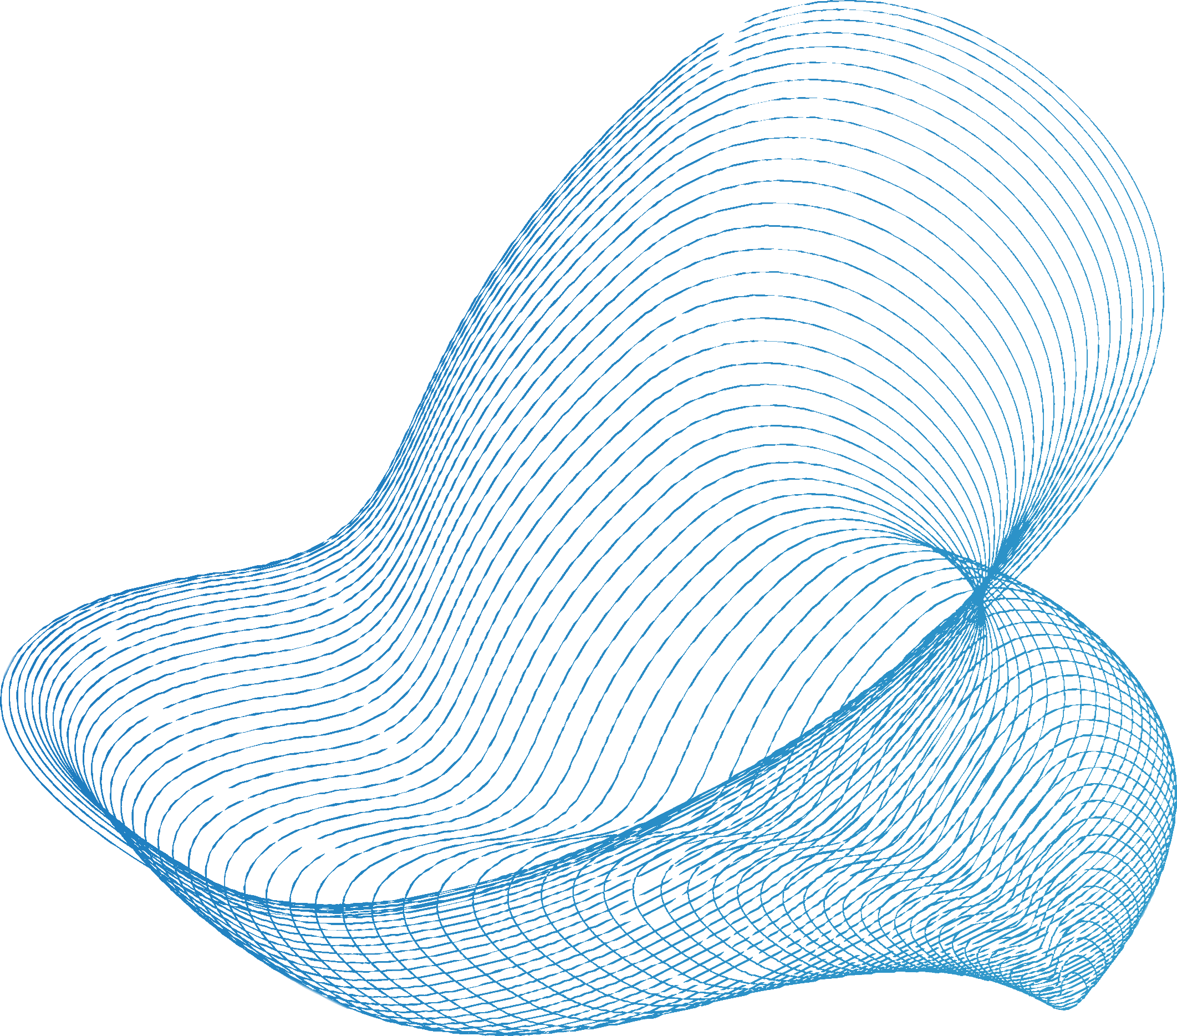
INTRODUCTION
Web development is the process of creating websites and web applications for the World Wide Web. It encompasses a diverse range of tasks, from designing the visual layout and user interface of a website to programming the server-side logic that powers web applications. Web development is a multidisciplinary field that combines creativity with technical skills to deliver online experiences to users worldwide.
Web development is a dynamic and continually evolving field, with new technologies, tools, and trends emerging regularly. Successful web developers not only possess technical expertise but also the ability to adapt to changes and embrace lifelong learning to stay competitive in the industry. Whether you're building a personal blog, an e-commerce platform, or a complex web application, web development offers a rewarding and creative career path.

Slide 4


KEY TECHNOLOGIES AND LANGUAGES
Web development relies on a variety of technologies and programming languages to create websites and web applications. These technologies and languages serve different purposes and are used at various stages of web development. Here are some key technologies and languages commonly used in web development:
Front-End Technologies and Languages:
HTML (Hypertext Markup Language) CSS (Cascading Style Sheets) JavaScript

Slide 5

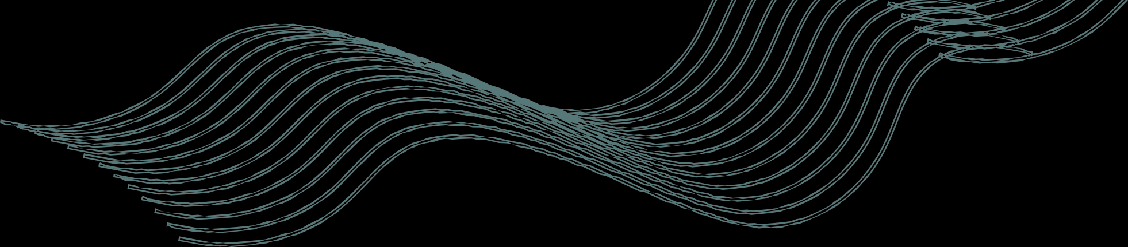

Front-End Frameworks:
Front-end frameworks like React, Angular, and Vue.js provide pre-built components and tools to simplify the development of complex, interactive web applications.
Back-End Technologies and Languages:
Server-Side Programming Languages: Back-end programming languages include: Python: Often used with frameworks like Django and Flask.
Ruby: Often used with the Ruby on Rails framework. PHP: Known for its role in server-side scripting.

Slide 6

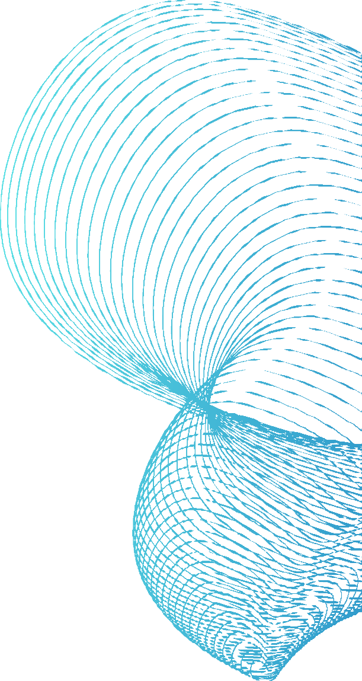
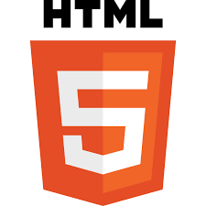

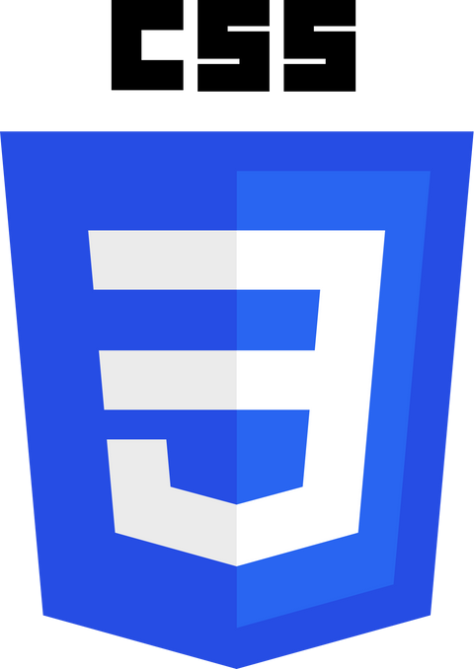
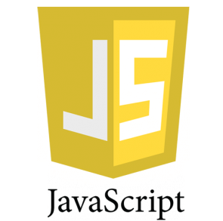

LANGUAGES
HTML CSS
JAVA SCRIPT

Slide 7

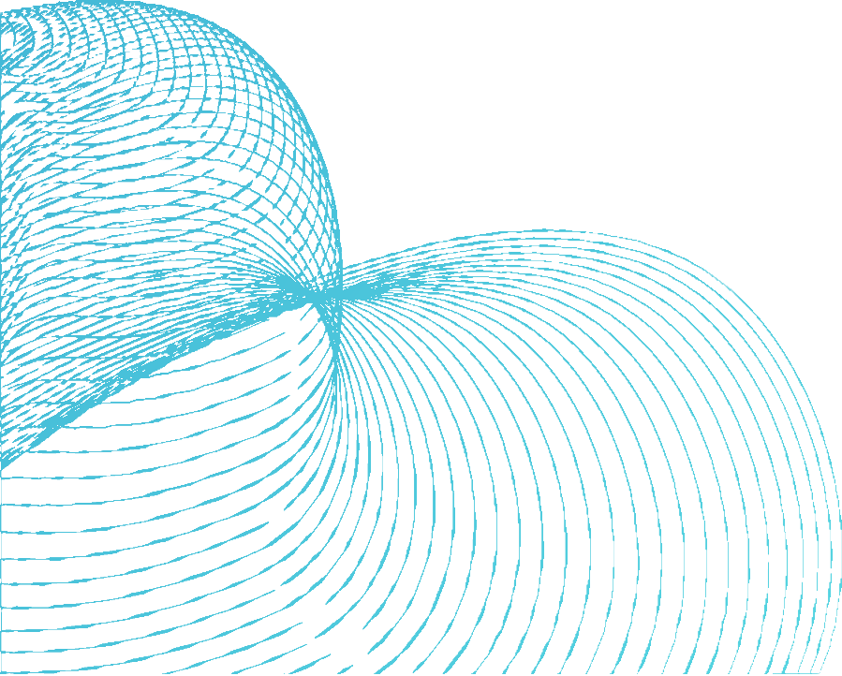
HTML
HTML documents consist of elements, which are represented by tags. Tags are enclosed within angle brackets (< >).
Elements:
HTML,
Markup markup
which stands Language," is
for "Hypertext the standard
language used to create and
HTML supports ordered lists (<ol>), unordered lists (<ul>), and definition lists (<dl>) to structure content into lists.
structure content on the World Wide Web. It serves as the foundation for building web pages by defining the structure and
Lists
elements of a webpage, such as text, images, links, forms, and more. HTML uses a system of tags (enclosed within angle brackets) to describe the elements on a web page. Here's a description of key aspects of HTML:
HTML provides form elements like
<form>, <input>, <textarea>,
<select>, and more for collecting user input and interacting with web servers.
Forms

Slide 8

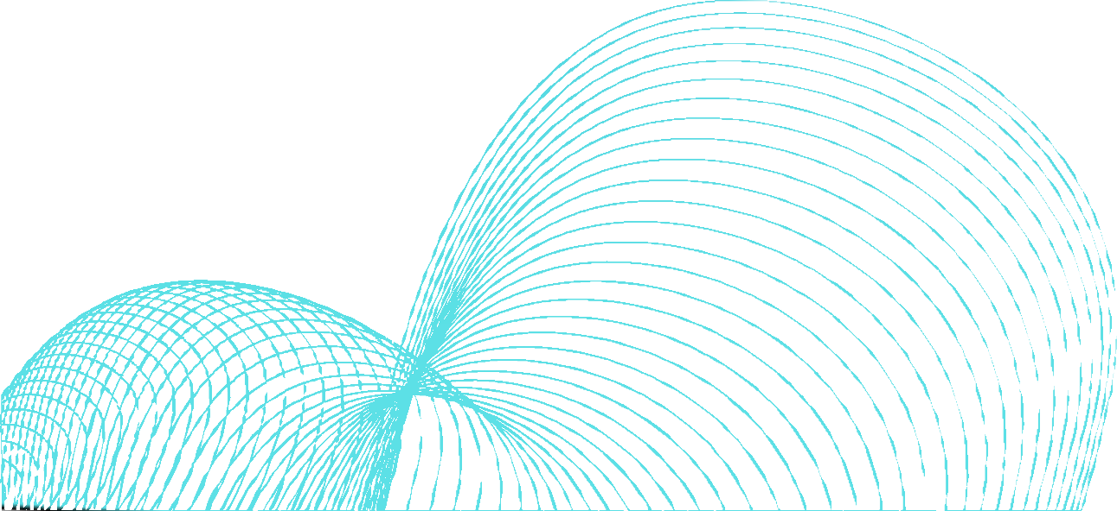
CSS
Colors
CSS supports a wide range of color representations, including named colors (e.g., "red," "blue"), hexadecimal values , RGB and RGBA values, and HSL
CSS, which stands for
"Cascading Style Sheets," is a
and HSLA values for more color specifications.
Transitions and Animations:
complex
stylesheet
describing the presentation
language used for
and visual documents
design written
of web in HTML
CSS supports transitions and animations,
enabling the creation of smooth, interactive effects like fade-ins, hover effects, and sliding menus.
and XML. It plays a crucial role
in web development by controlling the layout, styling, and appearance of web pages.
Compatibility
CSS is supported browsers, making
by all modern web it a universal and
essential technology for web design.

Slide 9

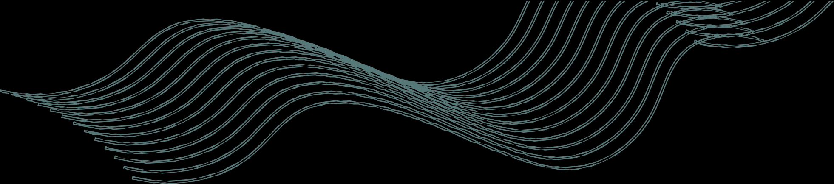
JAVA SCRIPT
JavaScript is a crucial programming language in web development. It enables dynamic and interactive features on websites. Developers use JavaScript to manipulate web page content, respond to user interactions, and communicate with web servers.
JavaScript runs in web browsers, allowing it to alter HTML and CSS in real-time. This makes it possible to create responsive user interfaces, validate forms, and provide smooth animations and transitions. Additionally, JavaScript supports asynchronous programming, which is essential for fetching data from servers without blocking the user interface.
Frameworks and libraries like React, Angular, and Vue.js simplify web development by providing reusable components and tools for building complex applications. Node.js extends JavaScript to the server-side, making it versatile for full-stack development.
Despite its power, JavaScript should be used judiciously to ensure accessibility, performance, and security. Proper coding practices and regular updates are essential to keep web applications stable and secure.

Slide 10



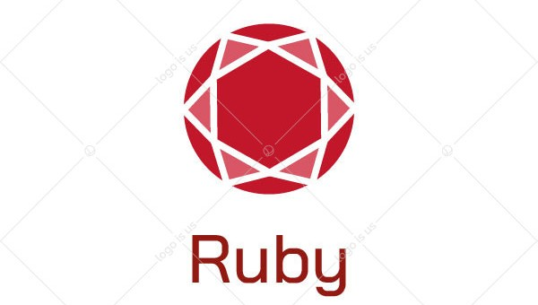


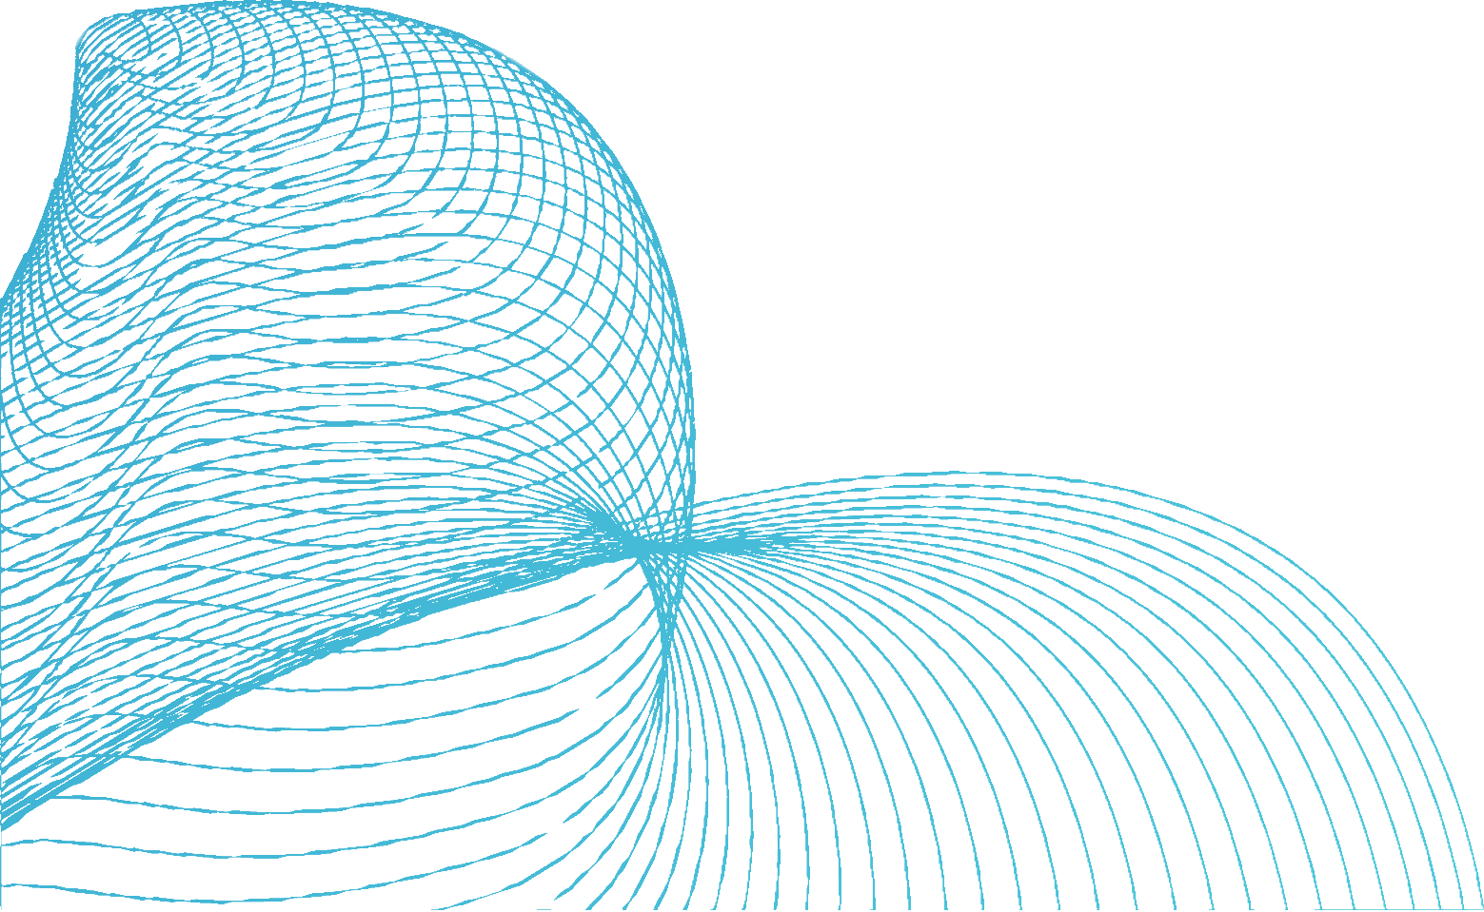

BACKEND LANGUAGES
PYTHON RUBY PHP

Slide 11

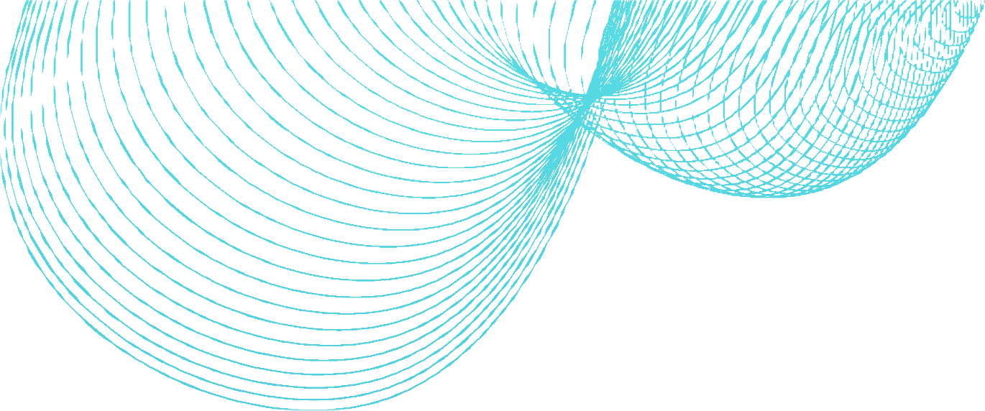

PYTHON
Python is a versatile language in web development, mainly on the server- side. Frameworks like Django and Flask simplify web app creation, handling everything from routing to databases. Python's readability and clean syntax make code maintenance easy. It integrates with popular databases, streamlining data management. Python is also used for web scraping, automating data collection from websites. Its vast library ecosystem includes tools like Requests for HTTP requests and Beautiful Soup for HTML parsing. Python's simplicity, readability, and robust frameworks make it an excellent choice for web app development, data manipulation, and automation tasks in the web development landscape.

Slide 12


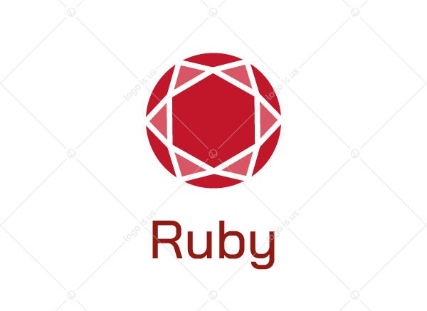
RUBY
Ruby is a dynamic and object-oriented programming language widely used in web development. The Ruby on Rails framework, often referred to as Rails, is a popular choice for building web applications. Rails follows the convention over configuration (CoC) and don't repeat yourself (DRY) principles, streamlining development by minimizing repetitive tasks. It offers robust tools for routing, database management, and templating. Ruby's elegant syntax and readability contribute to developer productivity. Overall, Ruby, with Rails, provides a powerful and efficient platform for building web applications.

Slide 13

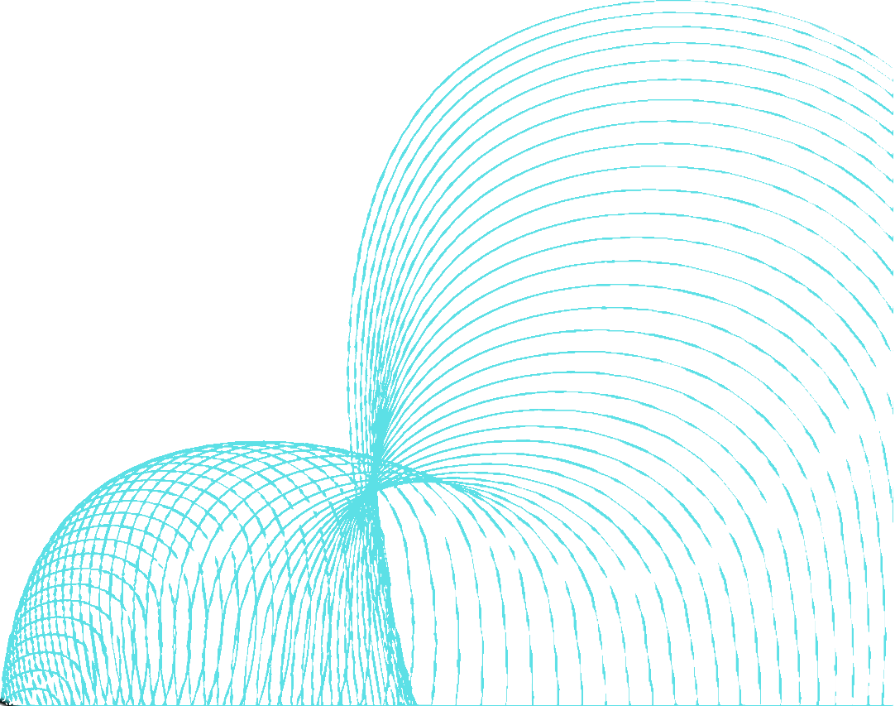
PHP
PHP is a server-side scripting language widely used in web development. It powers dynamic web pages and web applications. PHP integrates with databases, handles form data, and generates HTML content, making it a cornerstone of the web. Popular CMS platforms like WordPress are built with PHP, showcasing its importance in web development.
Performance:
Open Source:
PHP's performance has improved over the years, but for high-traffic and resource- intensive applications, developers may need to optimize code and consider other technologies or caching mechanisms.
This leads to a wealth of resources, libraries, and frameworks available for PHP development.

Slide 14

CONCLUSION
Web development is the backbone of the digital world, enabling the creation of websites and web applications that connect people, businesses, and information online. It encompasses front-end technologies like HTML, CSS, and JavaScript for user interface design and interactivity, while server-side languages and frameworks handle data processing and server communication. Developers must prioritize factors such as security, performance, and accessibility to deliver quality web experiences. With the constant evolution of technologies and the growing importance of mobile and responsive design, web development remains a dynamic and ever-changing field, shaping the way we interact with information and services on the internet.

Slide 15
THANK YOU

